Slide 1



KONGU ENGINEERING COLLEGE
PERUNDURAI ERODE-638060
DEPARTMENT OF COMPUTER APPLICATIONS
SMART CONSTRUCTION MATERIALS MANAGEMENT SYSTEM
Done by,
BALAJI HARIAHARN N S
24MCR008
Guide:
Dr.M.JAGADEESAN

Slide 2
INTRODUCTION
The construction industry is growing rapidly with increasing demand for cement and steel.
Traditional purchasing methods involve manual orders, phone calls, and physical visits.
These methods often cause delays, errors, and lack of proper tracking.
A digital platform is needed to simplify ordering, payment, and management.
This system provides an online solution for construction material procurement.

Slide 3
PROBLEM STATEMENTS
The current method of ordering construction materials is mostly manual, which consumes more time and requires extra effort from both customers and shop owners.
Customers and business owners face difficulty in tracking orders and payment status, as there is no proper system to view updates in real time.
The lack of real-time stock information makes it hard to know whether materials are available, leading to delays or incorrect orders.
Billing and record maintenance are often done manually, which increases the chance of mistakes and makes data management difficult.
There is no centralized platform for administrators to monitor products, orders, payments, and inventory efficiently.

Slide 4
PROPOSED SYSTEM
The system is developed as a web-based platform that helps in managing steel and cement materials easily through an online interface.
It provides automated handling of products, orders, and inventory, which reduces manual work and saves time.
The system includes a secure authentication mechanism to ensure that only authorized users and administrators can access their respective modules.
It offers real-time stock updates and order tracking, allowing users and admins to know the current status of materials and orders instantly.
An admin dashboard is provided to manage products, customers, orders, and payments efficiently from a single place.

Slide 5
SPECIFICATIONS
HARDWARE SPECIFICATIONS
SOFTWARE SPECIFICATIONS
➤ Processor : Intel i3 or equivalent
➤ Hard Disk : Minimum 20 GB
➤ RAM : Minimum 4 GB
➤ Keyboard : Standard 104 Keys
➤ Mouse : Wired / Wireless Mouse
➤ Operating System : Windows 10 / Windows 11
➤ Frontend : React.js (Vite)
➤ Backend : Node.js, Express.js
➤ Database : MongoDB
➤ Editor : Visual Studio Code
➤ Web Browser : Google Chrome / Microsoft Edge

Slide 6
SYSTEM DESIGNING
LAYER | TECHNOLOGY USED | DESIGN DESCRIPTION
Frontend | React.js (Vite) | Designs responsive and interactive user interface for product browsing, cart, checkout, and admin dashboard
Backend | Node.js | Handles server-side operations, request processing, and business logic
Backend Framework | Express.js | Provides RESTful APIs, routing, middleware support, and request validation
Database | MongoDB | Stores user details, product information, orders, stock data, and transaction records
Authentication | JWT (JSON Web Token) | Ensures secure login, session handling, and role-based access control
API Communication | Axios | Handles secure data exchange between frontend and backend
Authorization | Role-based Access | Controls access for admin and customer functionalities

Slide 7
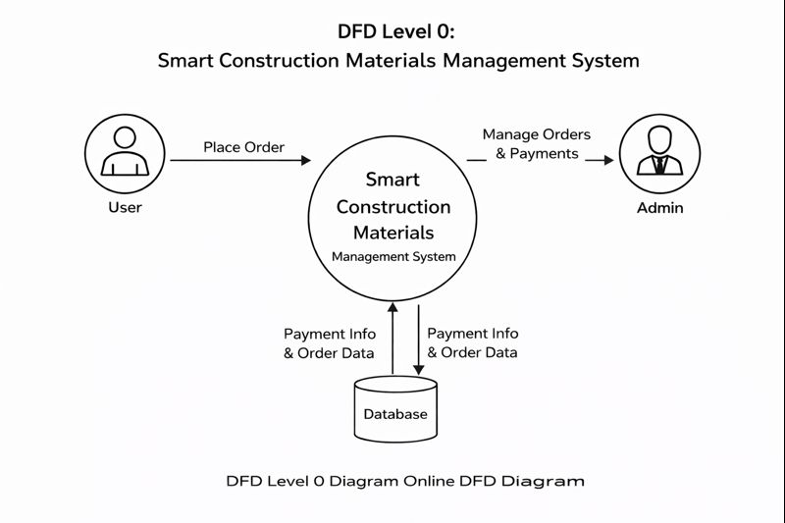
DFD Level 0

Slide 8
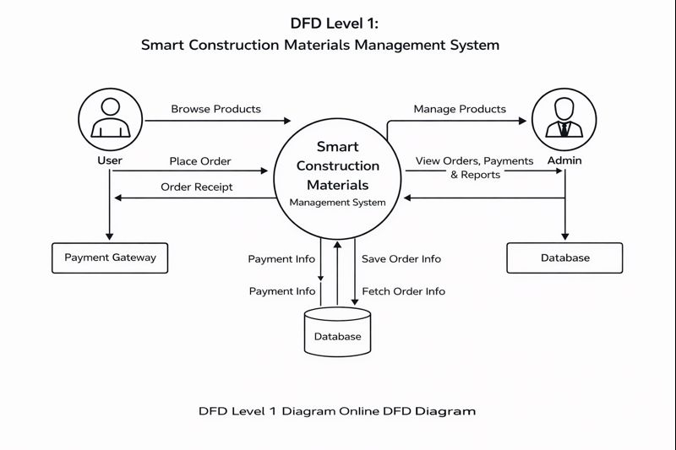
DFD Level 1

Slide 9
SYSTEM MODULES OVERVIEW
User Management Module
    Cart Management Module
    Order Management Module
    Payment Management Module
Admin Management Module
    Product Management Module
      Category Management Module (Cement, Steel, Others)
    Inventory & Stock Management Module
    Dashboard & Analytics Module

Slide 10
SYSTEM MODULES OVERVIEW
1. User Management Module
This module handles user registration, login, and profile management. It allows customers to securely create accounts, update personal details, reset passwords, and manage their order history. Authentication ensures that only authorized users can access the system.
2. Admin Management Module
The Admin Management Module provides full control over the system. Administrators can manage users, products, orders, payments, and inventory. It ensures secure access with role-based authentication and enables monitoring of overall system activities.

Slide 11
SYSTEM MODULES OVERVIEW
3. Product Management Module
This module allows the admin to add, update, view, and delete construction products. Product details such as name, price, description, images, and availability are maintained accurately to ensure a smooth shopping experience for users.
4. Category Management Module (Cement, Steel, Others)
The Category Management Module organizes products into categories like Cement, Steel, and Others. It helps users easily browse products and allows admins to manage category-wise listings efficiently.

Slide 12
SYSTEM MODULES OVERVIEW
5. Inventory & Stock Management Module
This module tracks real-time stock levels of all products. It automatically updates inventory when orders are placed and alerts the admin about low-stock or out-of-stock items, ensuring better stock control.
6. Cart Management Module
The Cart Management Module enables users to add, update, or remove products before checkout. It calculates the total cost dynamically based on quantity and price, providing a smooth pre-purchase experience.

Slide 13
SYSTEM MODULES OVERVIEW
7. Order Management Module
This module manages the complete order lifecycle. Admins can view, confirm, process, and update order statuses, while users can track their orders from placement to delivery.
8. Payment Management Module
The Payment Management Module handles secure online transactions. It supports payment processing, status tracking, and failure handling while ensuring data security and transaction reliability.

Slide 14
SYSTEM MODULES OVERVIEW
9. Receipt / Invoice Generation Module
This module generates a professional receipt or invoice after successful payment. It includes customer details, product information, pricing, taxes (if applicable), and payment status, and can be downloaded or printed.
10. Dashboard & Analytics Module
The Dashboard & Analytics Module provides a summarized view of system activities. It displays key metrics such as total sales, orders, payments, customers, and stock status using charts and reports to support decision-making.

Slide 15
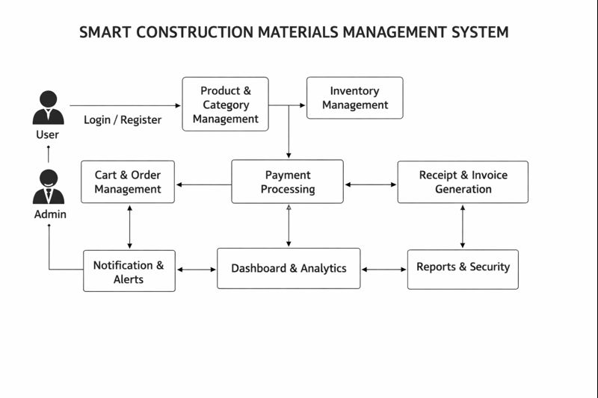
MODULE WORKFLOW DIAGRAM

Slide 16
DATABASE COLLECTION STRUCTURES
ORDER COLLECTION
{
"_id": ObjectId,
"user": ObjectId,
"items": [
{
"product": ObjectId,
"quantity": Number,
"price": Number
}
],
"totalAmount": Number,
"shippingAddress": {
"name": String,
"phone": String,
"addressLine": String,
"city": String,
"state": String,
"pincode": String
},
"paymentMethod": String,
"paymentIntentId": String,
"paymentStatus": String,
"orderStatus": String,
"notes": String,
"statusHistory": [
{
"status": String,
"updatedAt": Date
}
],
"orderNumber": String,
"createdAt": Date,
"updatedAt": Date,
"__v": Number
}

Slide 17
"amount": Number,
"currency": String,
"status": String,
"gatewayResponse": Object,
"failureReason": String,
"refundId": String,
"refundAmount": Number,
"refundDate": Date,
"refundReason": String,
"paymentDate": Date,
"createdAt": Date,
"updatedAt": Date,
"__v": Number
}
PAYMENT COLLECTION
{
"_id": ObjectId,
"order": ObjectId,
"orderNumber": String,
"user": ObjectId,
"customerName": String,
"customerEmail": String,
"customerPhone": String,
"paymentMethod": String,
"paymentId": String,
"transactionId": String,
"stripePaymentIntentId": String,

Slide 18
PRODUCT COLLECTION
{
"_id": ObjectId,
"productName": String,
"category": String,
"subcategory": String,
"brand": String,
"description": String,
"price": Number,
"unit": String,
"stockQuantity": Number,
"minOrderQuantity": Number,
"lowStockThreshold": Number,
"status": String,
"featured": Boolean,
"image": String,
"images": [String],
"tags": [String],
"createdAt": Date,
"updatedAt": Date,
"__v": Number
}

Slide 19
USER COLECTION
{
"_id": ObjectId,
"name": String,
"email": String,
"phone": String,
"password": String,
"role": String,
"authProvider": String,
"googleId": String,
"profilePicture": String,
"isActive": Boolean,
"emailVerified": Boolean,
"phoneVerified": Boolean,
"lastLogin": Date,
"createdAt": Date,
"__v": Number
}

Slide 20
SDG GOALS
SDG 8 – Decent Work and Economic Growth
Supports business growth and improves efficiency through digital systems.
SDG 9 – Industry, Innovation and Infrastructure
Encourages the use of modern technology in construction material management.
SDG 11 – Sustainable Cities and Communities
Helps in timely supply of construction materials for sustainable urban development.
SDG 16 – Peace, Justice and Strong Institutions
Secure transactions through proper records and billing.

